Slide 1
Treatment strategies to maximise patient benefit in metastatic colorectal cancer
Associate Professor Winston Liauw
Cancer Care Centre St George Hospital
@wsliauw

Slide 2
Case discussion
52 male with past history stage 3 (T4aN1M0) colon cancer at age 49. Rx with adjuvant FOLFOX. Has residual grade 1 neuropathy. Now presents with CEA 36. CT scan C/A/P shows liver metastases & PET scan shows no other disease.
What do you want to do?

Slide 3
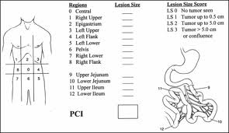
Case discussion
It is decided to proceed directly to surgery at the preference of the patient and the surgeon.
Intraoperative ultrasound discloses no new lesions but there is low volume peritoneal disease
The surgeon calls you from operating theatre. What do you want to do?

Slide 4
CASE DISCUSSION
The patient now comes to your rooms post surgery. The pathology disclosed completely resected liver disease and the surgeon removed all of the peritoneal disease.
What do you want to do?

Slide 5
Case discussion
1 year post liver resection CEA is normal but CT scan detects a 2 cm pulmonary nodule.
What do you want to do?

Slide 6
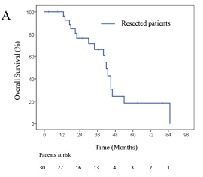

Slide 7
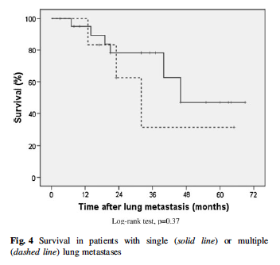

Slide 8
Treatment strategies to maximise patient benefit in metastatic colorectal cancer
Associate Professor Winston Liauw
Cancer Care Centre St George Hospital

Slide 9
objectives
THERE WAS A LIMITED AMOUNT OF TIME SO RATHER THAN UNDERTAKE AN EXHAUSTIVE DISCUSSION OF THE TRIALS I’VE DECIDED TO FOCUS ON STRATGEIC THINKING IN RELATION TO METASTATIC COLORECTAL CANCER MANAGEMENT

Slide 10

THE ART OF war against metastatic Colorectal cancer

Slide 11
“Strategy without tactics is the slowest route to victory. Tactics without strategy is the noise before defeat”
SUN TZU, The Art of War

Slide 12
“If ignorant both of your enemy and yourself, you are certain to be in peril”
SUN TZU, The Art of War

Slide 13
understand
The disease you are treating
Your own approach to treatment
The preferences and understanding of the patient

Slide 14
Understand the disease
BIOLOGICAL CONSIDERATIONS
  STAGE & PATTERN OF SPREAD
  TUMOUR IMMUNOLOGY
  GENOTYPE & PHENOTYPE
THE AIM IS TO BE ABLE TO PROGNOSTICATE
  WHERE WILL RELAPSE / PROGRESSION OCCUR
  WHAT IS THE NATURAL AND MODIFIABLE TEMPO OF THE DISEASE
THE OTHER AIM IS TO DETERMINE THE BEST TOOLS FOR TREATMENT
  TAILORING THERAPY

Slide 15
Understand the disease
METASTATIC COLORECTAL CANCER
CAN BE A CHRONIC DISEASE
AND CAN BE CURED

Slide 16
WHAT IS YOUR APPROACH TO TREATMENT?
THERE IS NO DOUBT THAT DIFFERENT ONCOLOGISTS HAVE DIFFERENT APPROACHES TO TREATMENT – SOME ARE CONSIDERED ‘AGGRESSIVE’ AND OTHERS ‘CONSERVATIVE’
ANOTHER PERSPECTIVE COULD BE ‘CREATIVE’ VERSUS ‘UNCREATIVE’
  HOW DO YOU USE THE EVIDENCE?
  DO YOU KNOW THE OLDER LITERATURE & ALTERNATIVE AGENTS

Slide 17
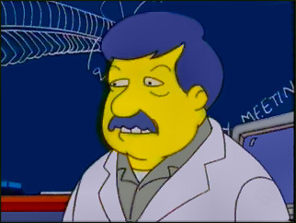
WHAT IS YOUR APPROACH TO TREATMENT?
QUANTITY OF LIFE VERSUS QUALITY OF LIFE
THE MEDIAN ISN’T THE MESSAGE
IS THERE A LONG TAIL?

Slide 18
UNDERSTAND THE PATIENT
TAKE INTO CONSIDERATION THE MEDICAL FACTORS
  AGE
  COMORBIDITIES
  ORGAN DYSFUNCTION
TAKE INTO CONSIDERATION THE PATIENT PREFERENCES
  SOME WANT AGGRESSIVE THERAPY TO GAIN TIME
  SOME WANT TO FOCUS ON QUALITY OF LIFE
  SOME HAVE SPECIFIC GOALS
  UNDERLYING BELIEFS ARE IMPORTANT

Slide 19
SOME GUIDING PRINCIPLES
CONSIDER THE OVERALL APPROACH TO THE PROBLEM: WHAT IS THE TREATMENT INTENT?
UNDERTAKE (OR AIM TO UNDERTAKE) COMPLETE CYTOREDUCTION / RESECTION / ABLATION WHENEVER FEASIBLE
WITHIN EXPECTED PATIENT TOLERANCE USE THE MOST ACTIVE THERAPY FOR PHARMACOLOGICAL DEBULKING

Slide 20
Some guiding principles
WHERE POSSIBLE TAILOR THE PHARMACOTHERAPY (PHARMACOGENETICS)
EXPLOIT THE HALLMARKS OF CANCER
USE MAINTENANCE THERAPY WHERE POSSIBLE
CONSIDER RE-CHALLENGE

Slide 21
CAVEATS TO THE GUIDING PRINCIPLES
TAKE A TOXICITY SPARING APPROACH
AVOID BURNING BRIDGES TOO EARLY

Slide 22
WHAT IS THE INTENT OF TREATMENT?
DETERMINING THE INTENT OF TREATMENT HELPS DETERMINE THE TREATMENT CHOICE
E.G. YOUNG PERSON WITH BILOBAR LIVER METASTASES POTENTIALLY TREATABLE WITH 2-STAGE LIVER RESECTION WITH INTENT TO CURE
  USE MOST INTENSE REGIMEN E.G. FOLFOXIRI + BEVACIZUMAB
C.W. ELDERLY PERSON WITH SAME DISEASE AND THE INTENT IS PALLIATION
  USE LESS INTENSE CHEMOTHERAPY

Slide 23
UNDERTAKE RESECTION WHEN POSSIBLE
ALMOST REGARDLESS OF THE SITE OF METASTASIS SURGICAL THE 5 –YEAR SURVIVAL IS 25% IF R0 RESECTION IS ACHIEVED

Slide 24
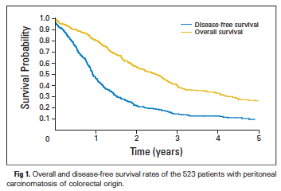
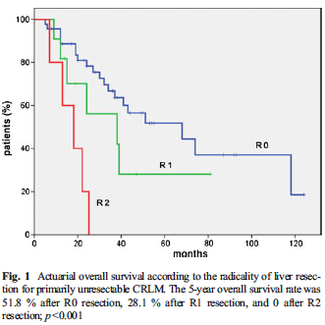
J Clin Oncol. 2010; 28(1):63-8.
J Gastrointest Surg. 2013;17(2):352-9

Slide 25
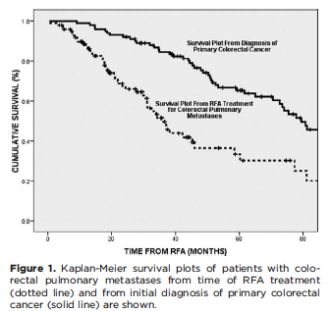
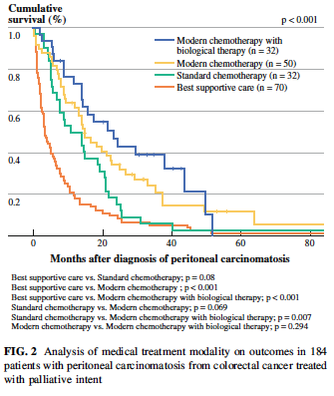
Cancer. 2010;116(9):2106-14.
Ann Surg Oncol 2011; 18: 1560

Slide 26
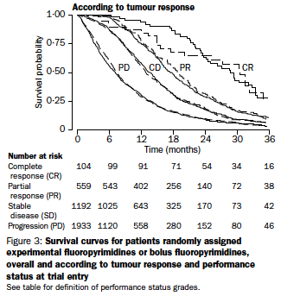
WITHIN EXPECTED PATIENT TOLERANCE USE THE MOST ACTIVE THERAPY FOR PHARMACOLOGICAL DEBULKING

Slide 27
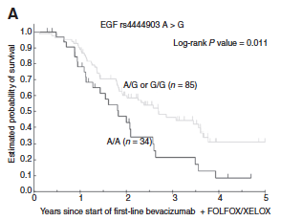
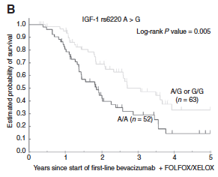
WHERE POSSIBLE TAILOR THE PHARMACOTHERAPY (PHARMACOGENETICS)

Slide 28
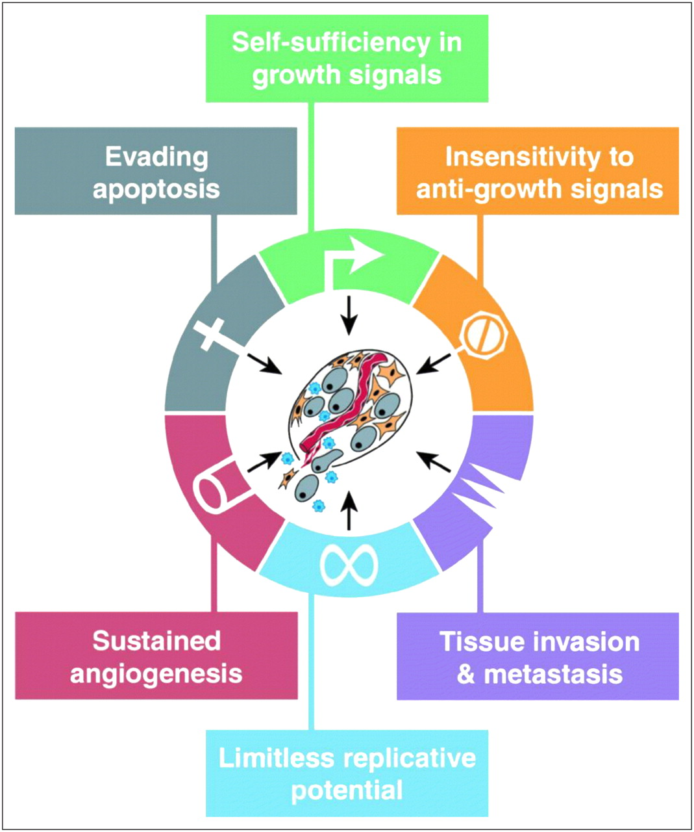
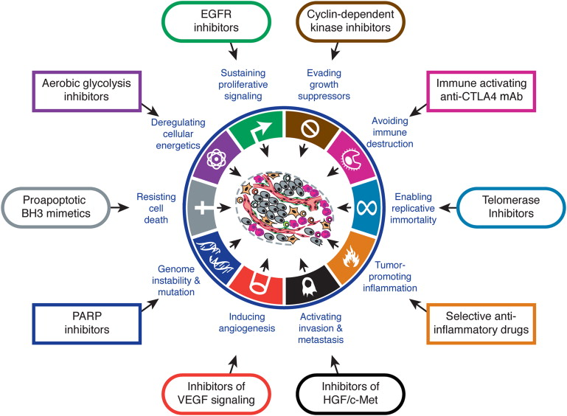
EXPLOIT THE HALLMARKS OF CANCER

Slide 29
Exploit the hallmarks of cancer
By targeting more than one hallmark simultaneously one might achieve better results
In particular there is the case that continuing treatment beyond progression may be advantageous for some of the hallmarks:
  Bevacizumab in colon cancer
  Trastuzumab in breast cancer
  Hormonal therapy
In addition some combinations may reverse resistance e.g. cetuximab and irinotecan

Slide 30
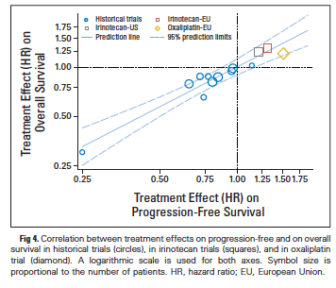
USE MAINTENANCE THERAPY WHERE POSSIBLE

Slide 31
USE MAINTENANCE THERAPY WHERE POSSIBLE
Current evidence is mixed and there aren’t clear rules.
Guidelines:
  Oxaliplatin re-introduction feasible and generally safe
  Maintenance probably translates in to small survival increment
  Treatment break probably translates into small QOL increment
  Time off chemotherapy generally short
  Use the prognostic factors relevant from the original presentation to guide choices
  Use patient preferences

Slide 32
USE MAINTENANCE THERAPY WHERE POSSIBLE
If the cancer doesn’t progress, and the patient is well, the patient will live longer
Currently the main strategy is maintenance chemotherapy +/- biological agent
Future role for immunotherapy

Slide 33
CONSIDER RE-CHALLENGE
We assume that a cancer is resistant to a therapeutic agent after prior progression
In practice given the long time frames re-challenge is possble
  Oxaliplatin both in post-adjuvant and protracted treatment setttings

Slide 34
Caveat: take a toxicity sparing approach
One of the problems is cumulative toxicity, particularly with oxaliplatin
There has been historical trend to use oxaliplatin in first-line rather than irinotecan but it may be better to do in reverse
Paradoxically some of the combinations (FOLFIRI vs irinotecan) might have more favourable profile

Slide 35
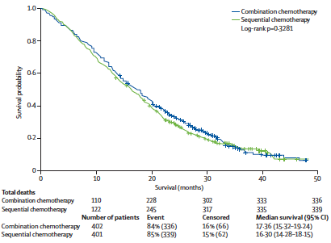
Caveat: avoid burning bridges too early

Slide 36
SUMMARISING THE STRATEGY
USE ALL OF THE AVAILABLE TOOLS (TACTICS)
BUT TAILOR THEIR USE TO THE INTENT OF THE TREATMENT
WITH THE OVERALL STRATEGY OF PROVIDING THE LONGEST DURATION OF LIFE WITH THE BEST POSSIBLE QUALITY OF LIFE AND THE LEAST AMOUNT OF TOXICITY

Slide 37
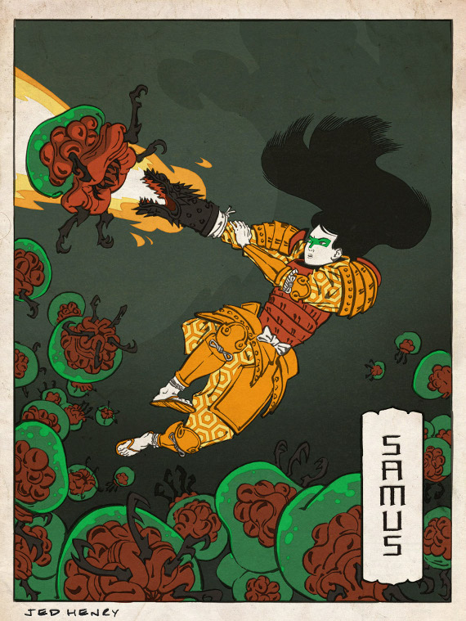
“many calculations lead to victory, and few calculations to defeat”
Sun Tzu, The Art of War

